Slide 1
Generating Synthetic Flight Tracks using GANs
Team Innovision Squad

Slide 2
Innovision Squad
Nikhil Kumar Jamma Scrum Master
Karthik Raja Bandaru Developer
Anurag Goud Koukuntla Product Owner
Abhigna Suman Aemjal Developer
Charan Indhukuru Mani Developer
Neelima Palleboina Developer

Slide 3
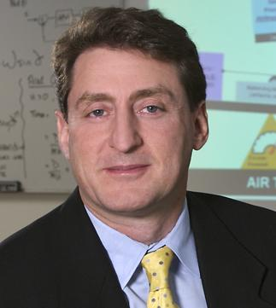
Our Partner
GMU CENTRE FOR AVIATION TRANSPORTATION SYSTEMS RESEARCH (CATSR)
Point of Contact:
Our POC is Dr. Lance Sherry, Associate Professor, Director at Center for Air Transportation Systems Research; Department of Systems Engineering and Operations Research.
CATSR is dedicated to advancing Air Transportation System Engineering through a multifaceted approach.
Few contributions of CATSR include:
complex adaptive systems simulation and analysis
NAS, airport and airspace simulation and performance analysis
rare-event safety analysis for systems and devices

Slide 4
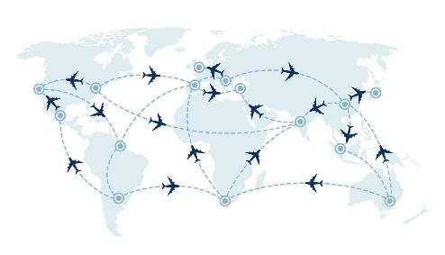
Problem Statement
Problem Statement:
Current Air-to-air collision Risk Modelling (CRM) relies on historic and simulated flight tracks. However, historic tracks may not represent new technologies, and simulating enough tracks is challenging.
To address this, our project aims to apply Generative Adversarial Networks (GANs) to generate over 1 million synthetic flight tracks by training a neural network on historic data. This innovative approach seeks to enhance accuracy and adaptability for airspace design and approval.
Domain of problem: Aviation Safety
Importance of problem: Using historic flight paths to predict collisions in the air can be a problem because it doesn't consider new technologies and procedures. This might make safety measures inadequate and increase the chance of collisions as aviation evolves.

Slide 5
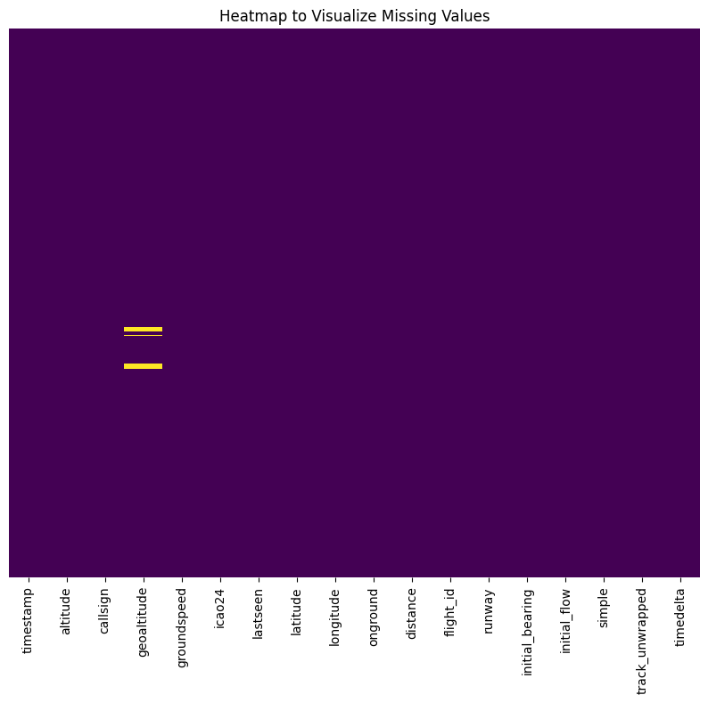
About our Data
The Zurich runway dataset keeps track of airplane paths and their characteristics.
It includes important time-stamped events during flights from October 1st to November 30th, 2019, in UTC.
Key details like geographic coordinates, groundspeed, altitude, and geoaltitude offer a complete spatial picture.
The dataset is nearly complete, aside from 1400 missing values in the "geoaltitude" column, which were later removed as they constitute for only 1.9% of the dataset.

Slide 6
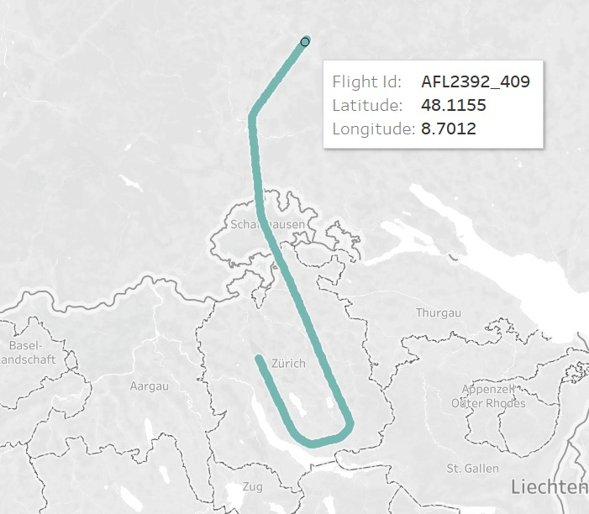
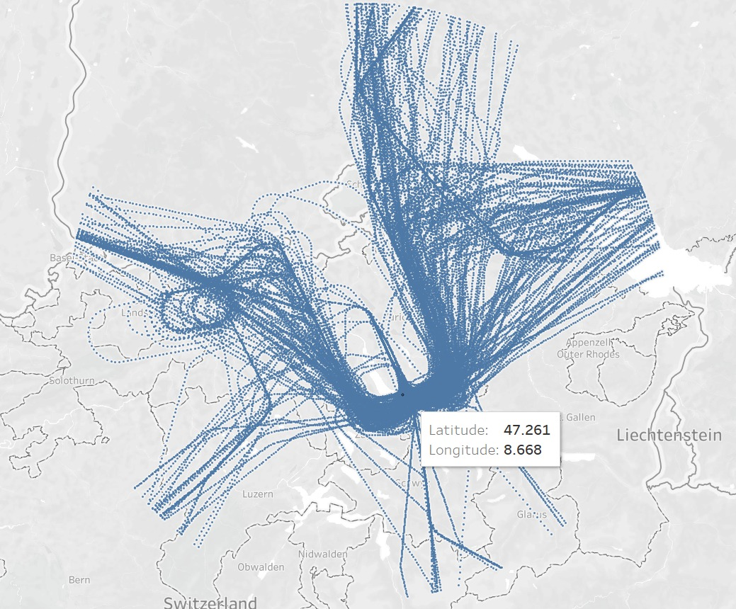
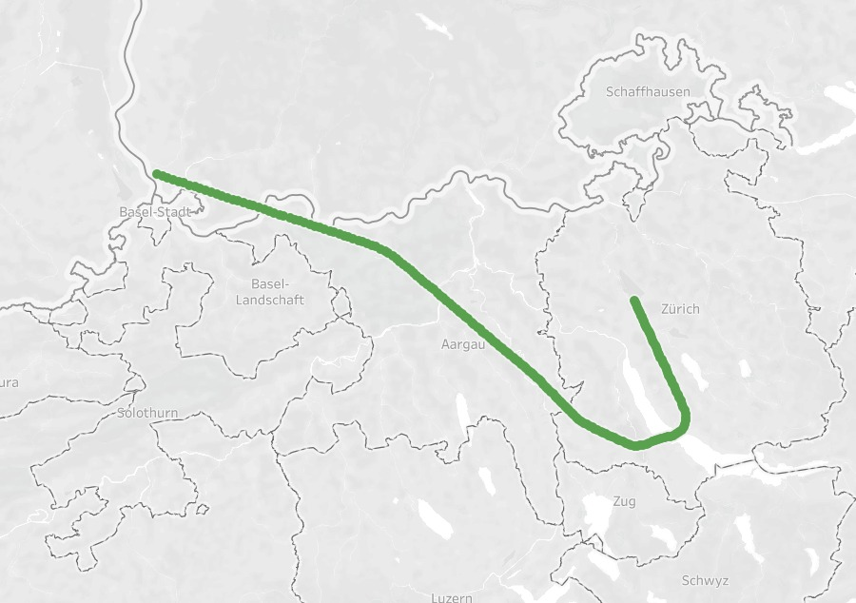
About our Data
Sample Flight Tracks
The dataset features 350 unique "flight_id" values, each associated with precisely 200 data records.
Latitude and Longitude accurately depict expected flight paths, and groundspeed values correspond to normal aircraft speeds, confirming the dataset’s accuracy.

Slide 7


Workspace
Google Colab
Hopper Cluster
Utilizing Google Colab, we effectively streamlined our data preprocessing tasks, utilizing its computing power to efficiently clean and format our dataset.
Through visualizations and basic analytical techniques, we gained a deeper understanding of our data, laying the groundwork for informed decision-making and further analysis in our project.
We used Mason Hopper cluster for distributed training and testing of the implementation models.
We benefited from the cluster's robust hardware and fast networking capabilities to handle large datasets efficiently.
We distributed tasks across multiple nodes in the cluster to accelerate computing speed and optimize training performance.

Slide 8
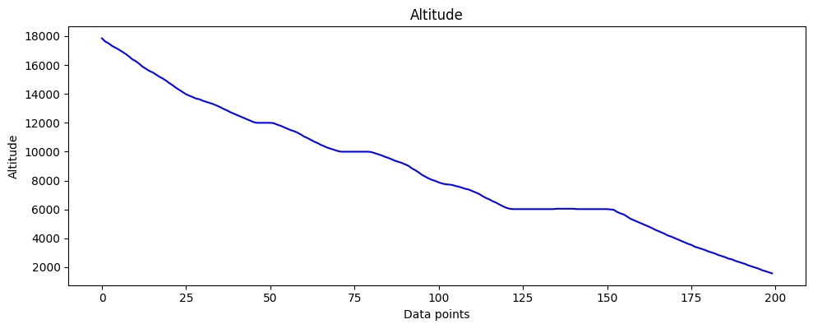
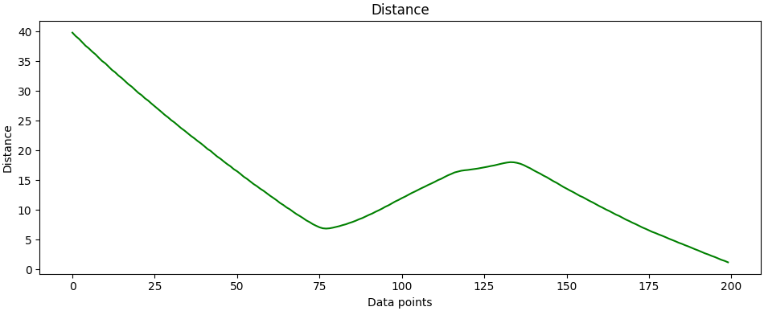
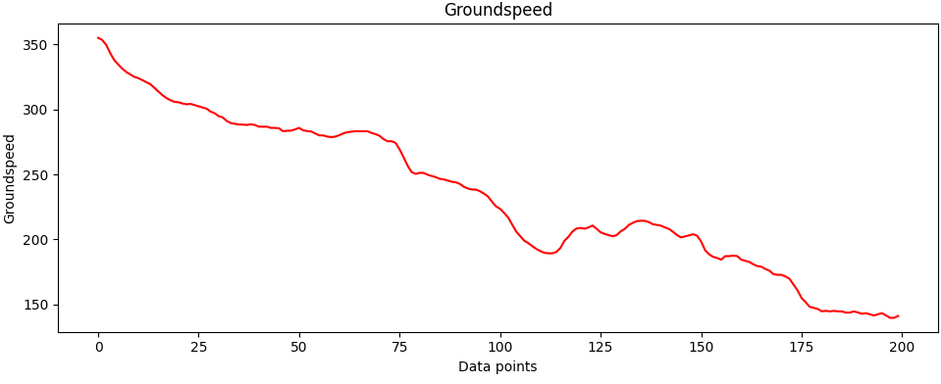
Exploratory Data Analysis
We can visualize the trajectory of a single flight from our dataset, tracking the fluctuation of 200 data points over time.
In every flight, the altitude starts high and gradually descends to 1000 feet upon landing.

Slide 9
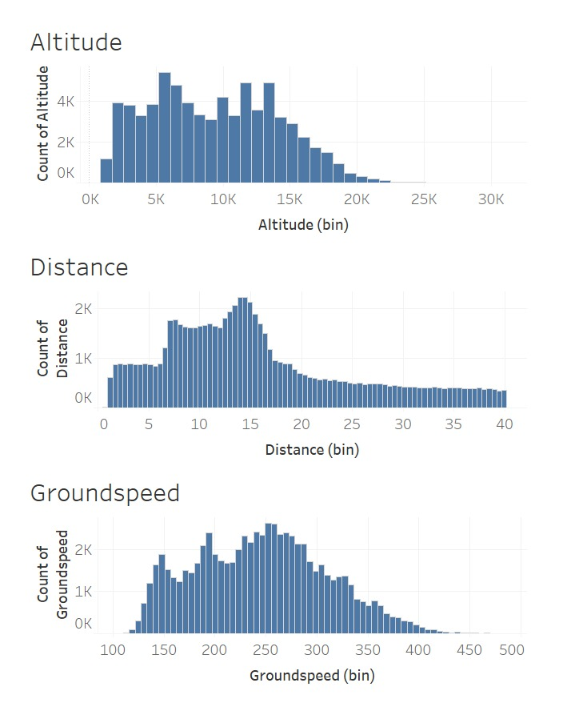
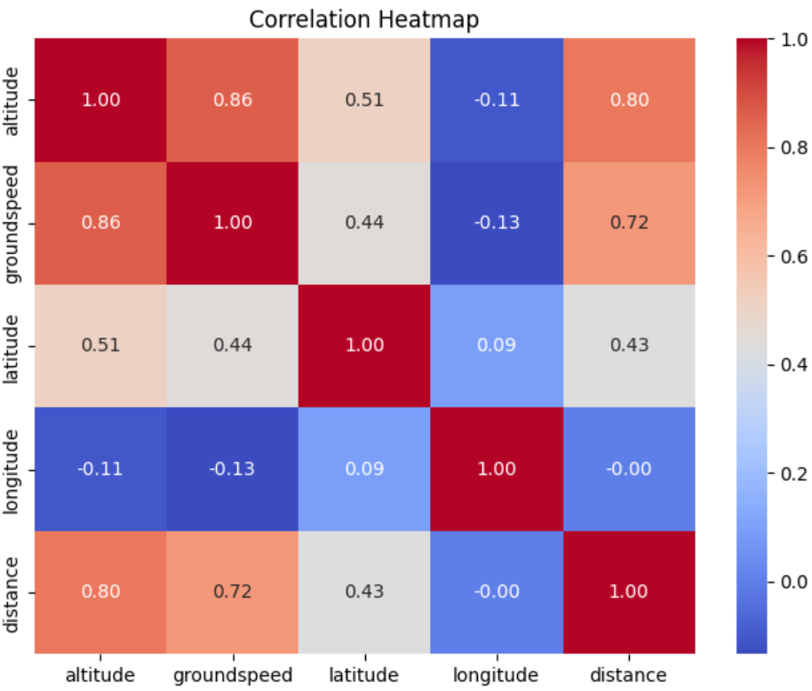
Exploratory Data Analysis
We observed high correlation between groundspeed, altitude and distance.

Slide 10
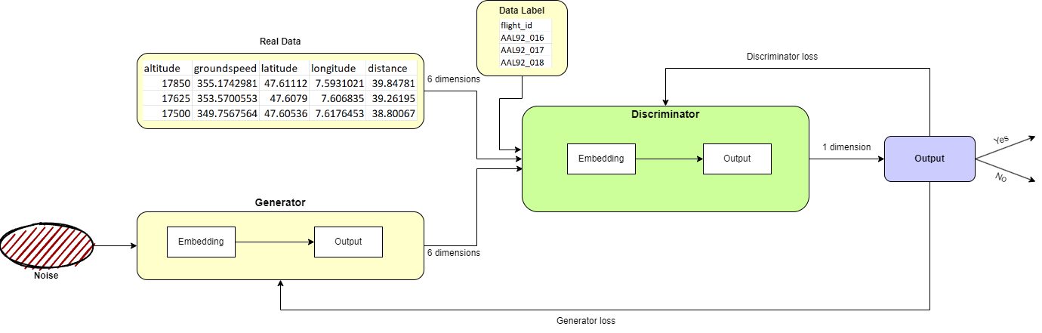
Algorithms and Analytics
CGAN implementation
GAN basically has 2 concurrent neural networks (Generator, Discriminator) and is primarily used for image generation.
We implemented this framework along with a data label (CGAN) to generate our flight track data.
The results were not acceptable as the data generated was in the limitations of original data, but they were not being generated in a sequence.

Slide 11
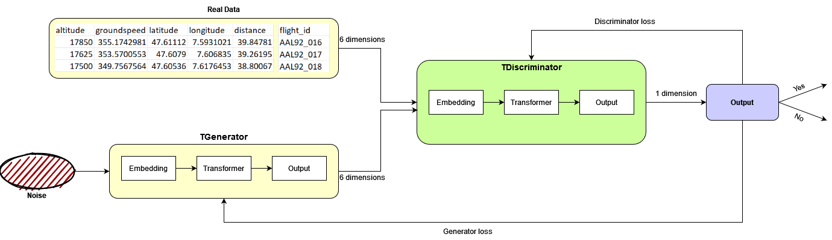
Algorithms and Analytics
TGAN implementation
Transformers are mainly used in NLP for sequence-to-sequence text generation. They usually work with large amounts of data.(Ex: ChatGPT)
We implemented the model by leveraging the self-attention mechanism of transformers, so that it can learn long-range dependencies in the sequential numeric data.
With only 350 sequences in our dataset, the model struggled to achieve satisfactory performance and generate high-quality results.

Slide 12
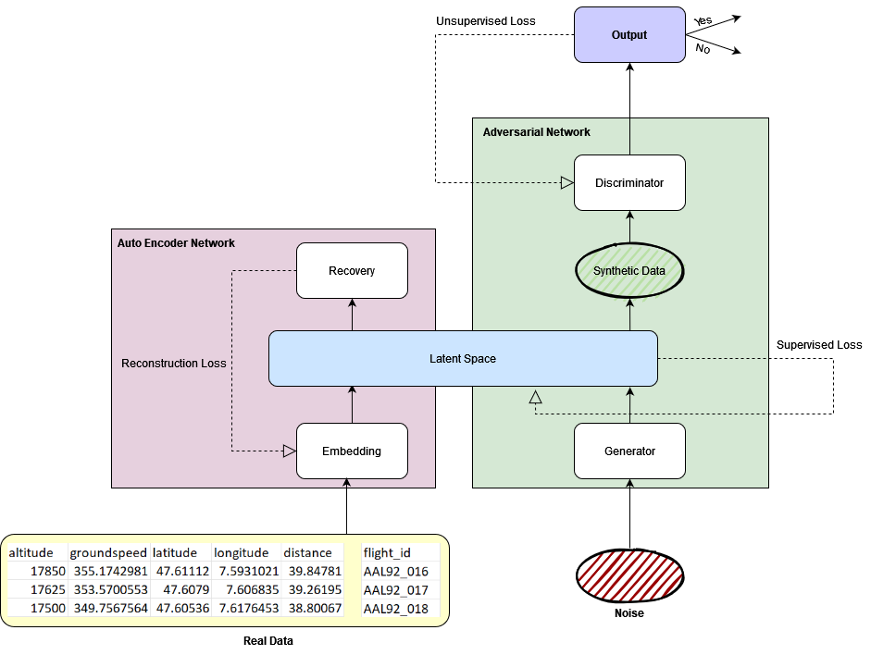
Algorithms and Analytics
RNN-GAN implementation
A recurrent neural network (RNN) is a type of artificial neural network which uses sequential data or time series data.
We implemented RNN using GRU, instead of only using two CNNs we add two new RNN layers called Embedding and Supervisor.
Embedding layer converts dataset into a latent space with less dimensions.
Supervisor layer is present in the Latent Space, and it makes sure that Generator and Discriminator learn the temporal sequence pattern of the dataset.
Notes:
Embedding layer converts dataset into a latent space with less dimensions compared to original. This preserves the relation among the features and helps the model understand the relation better.
The goal of Supervisor layer is to make sure that Generator and Discriminator learn the temporal sequence pattern of the dataset.
Another layer named Recovery converts the less dimensional data back into normal space for analyzing the results.

Slide 13
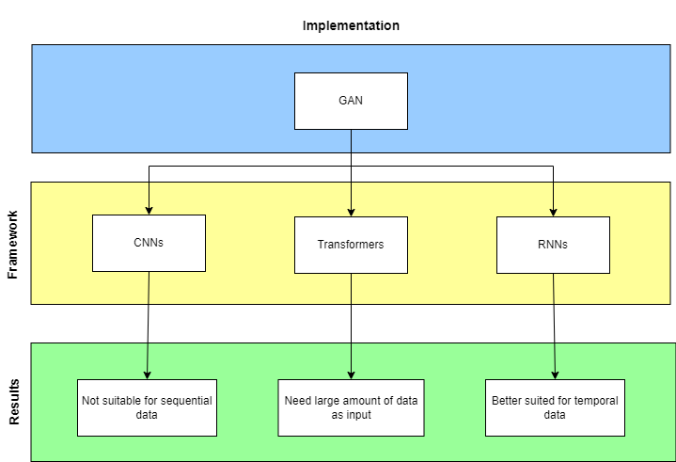
Algorithms and Analytics
Summary

Slide 14
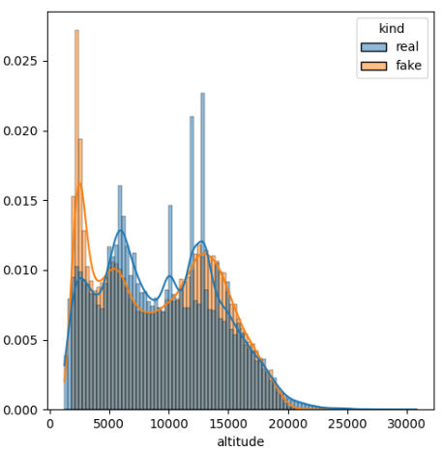
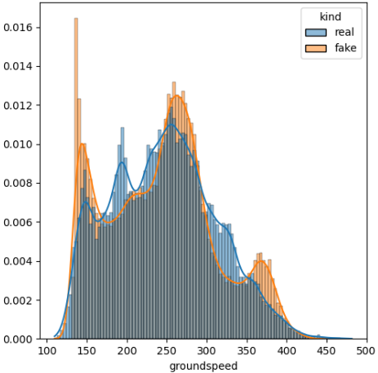
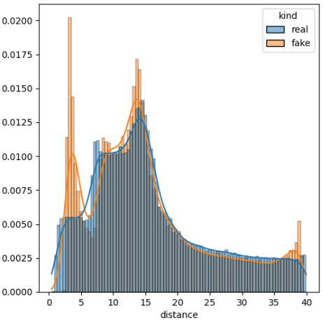
Visualizations
We observe from the visuals that the synthetic data mimics the pattern of the real dataset, displaying a similar structure.
The model effectively captured the pattern present in the real dataset.

Slide 15
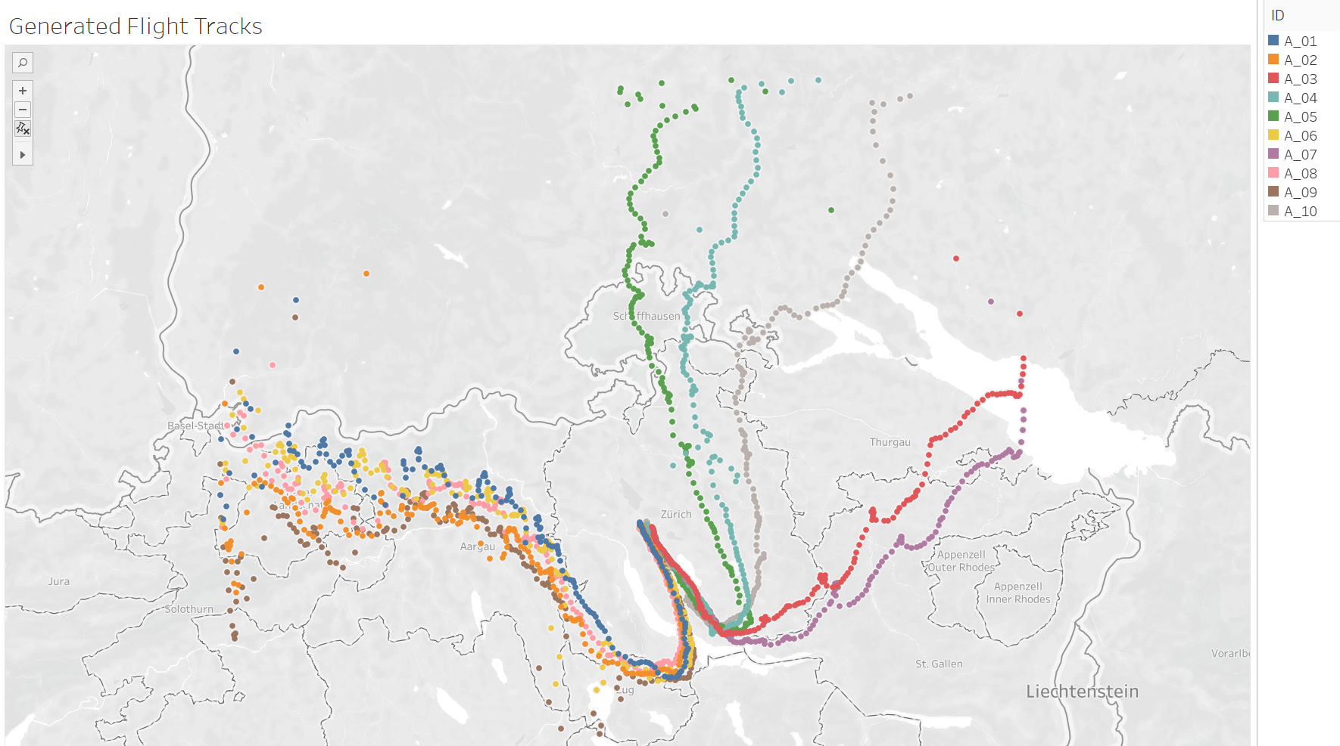
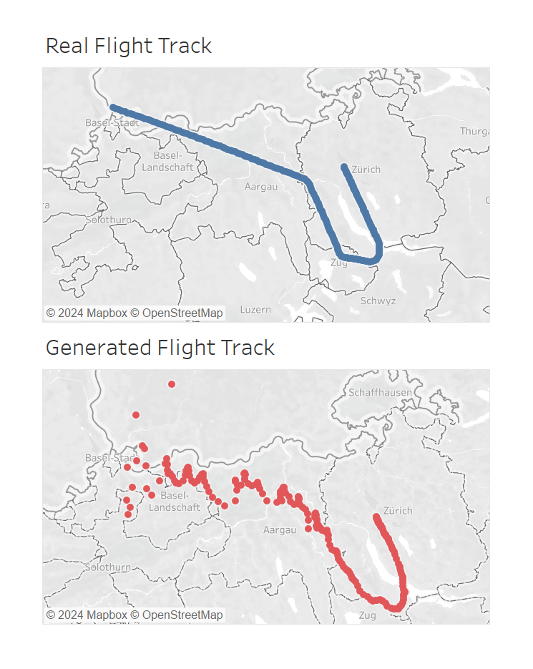
Visualizations
The generated flight tracks exhibit a convergence towards a single endpoint, mirroring the behavior of the real dataset.
These tracks closely resemble real data, following paths that lead to the Zurich runway, just like the flight tracks in the actual dataset.
Notes:
These tracks closely resemble actual flight paths, following similar trajectories to the real data, and concluding at the Zurich runway, just like the flight tracks in the real dataset.

Slide 16

Future Work
Improve the model further to generate end-to-end flight tracks that are even more realistic, exhibiting reduced margin of error and exceptional accuracy.
Develop improved validation metrics, collaborating with industry stakeholders.
Integrate synthetic flight tracks into existing CRM systems for better analysis.
Also explore applications beyond CRM, such as airspace design optimization.

Slide 17

Summary
Our project aims to tackle the challenge of improving air-to-air collision risk modeling (CRM) in the aviation industry.
To address this, we set out to implement Generative Adversarial Networks (GANs) to generate over one million synthetic flight tracks that could enhance the adaptability and precision of CRM.
We explored various model architectures which showed some promise, they ultimately struggled to generate the sequential and orderly data needed for realistic flight tracks.
Finally, we were able to develop a working model by incorporating Recurrent Neural Networks (RNNs) into the GAN framework, inspired by findings from the TimeGAN research paper.
Our project has important implications for improving the reliability and safety of Collision Risk Modeling, which is crucial for safer air travel.

Slide 18
Questions

Slide 19
Thank you

